Slide 1
Heirs’ Property Workshop
[ORG NAME]
[DATE]

Slide 2
AGENDA
Introduction – [SPEAKER NAME]
Topic #1 – [SPEAKER #1 – ORG NAME]
Topic #2 – [SPEAKER #2 – LISC Jacksonville]
Topic #3 – [SPEAKER #3 – Three Rivers Legal Services]
Wrap-Up & Next Steps – [SPEAKER NAME]

Slide 3
HEIR’S PROPERTY WORKSHOP
ORGANIZATION
LOGO
HERE
[SPEAKER NAME

Slide 4
HEIRS’ PROPERTY

Slide 5
HEIR’S PROPERTY WORKSHOP
KRISTOPHER SMITH

Slide 6
What is Heirs’ Property?

Slide 7
WHAT IS HEIRS’ PROPERTY?
Heirs’ property is property inherited without a will, estate plan, or court document from the owner who has passed away. This causes unclear or disputed legal title ownership for the descendants, blocking access to home equity loans and disaster relief programs, and prevents you from passing your home to the next generation.

Slide 8
Our Strategic Approach
LISC & partners utilize data to identify neighborhoods
Residents and partners design interventions
$
LISC provides resources to support interventions
Ownership is preserved and equity gains accrued
Notes:
Our Intent is to provide the resources and information that empower people to determine their destiny. For example, LISC secured a10K grant for resident led North Riverside CDC. After reviewing the neighborhood market data, the CDC chose to create a property tax relief fund that will help residents avert displacement due to tax arrears.

Slide 9
Jacksonville Key Facts
Pop. 949K, net increase of 3.06% over past 24 months
33% Americans have a will
50% increase in wills among Millennials since COVID

Slide 10
COMMUNITY OUTREACH & EDUCATION
LISC Jacksonville is leveraging the capacity of trusted organizations and messengers to share information with residents about the importance of wealth preservation, property tax relief, exemption enrollment, and estate planning.
LISC is providing technical assistance to reduce barriers so residents can understand how to access free civil representation and protect their assets.

Slide 11
CREATING PARTNERSHIPS
Over the next two years, LISC Jacksonville aims to collaborate across the county to address the issues associated with heirs’ property.
This includes several components such as exploring nomenclature patterns within the tax office that make vulnerable properties available within our most fragile communities, as well as working to locate priority neighborhoods for intensive outreach, and continuing to advance practical solutions.

Slide 12
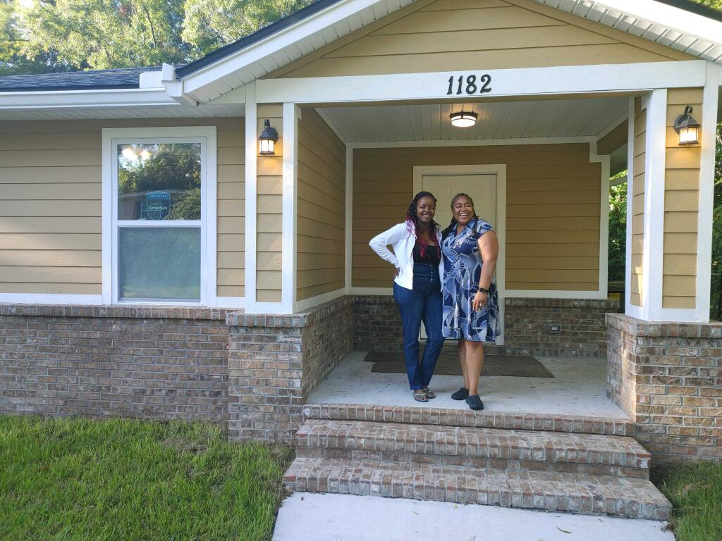
HEIRS’ PROPERTY
Three Rivers Legal Services

Slide 13
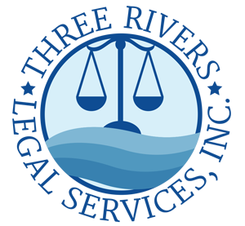
HEIR’S PROPERTY WORKSHOP
[SPEAKER NAME]

Slide 14
HEIR’S PROPERTY WORKSHOP
[PLACEHOLDER SLIDE FOR THREE RIVERS LEGAL SERVICES SPEAKER]

Slide 16
THANK YOU!
H E I R ’ S P R O P E R T Y W O R K S H O P

